Slide 1
Title : Artifactory
Authored and Presented by : Pratiksha Misal

Slide 2
Agenda
What is Artifactory?
Why Artifactory?
Artifactory Architecture
Difference between Artifactory and nexus ?
Features of Artifactory
Different repositories
Integration with Atlassian tools and other tools

Slide 3
What is Artifactory?
Its an advanced binaries repository manager- the binaries SCM
It caches remote artifacts so that you don’t have to download them over and over again.
You can gain full control over all the build artifacts and third-party dependencies your organization uses.

Slide 4
Why Artifactory?
Open Source project.
Its an repository manager
- Artifacts storage
- Avoid hitting public remote repositories
- Efficiency ,Security , Automation
- Deploy, manage and share local artifacts
- Full control over artifacts resolution and delivery
Integrate with any build tool- Maven, Gradle, Ivy and more.
Deploy through industry standard CI servers-Jenkins, TeamCity, Bamboo and more. Even cloud-based CI servers are supported.

Slide 5
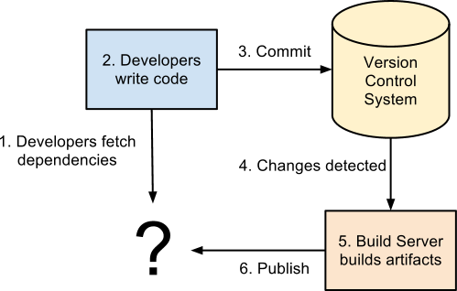
Why Artifactory-Cont…

Slide 6
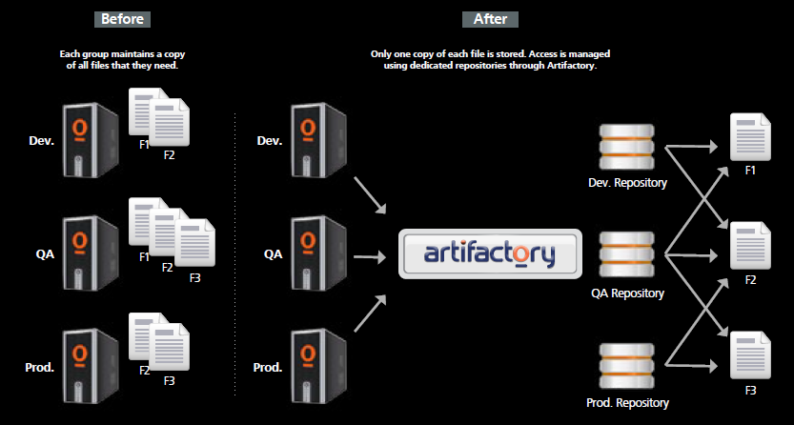
Why Artifactory-Cont…

Slide 7
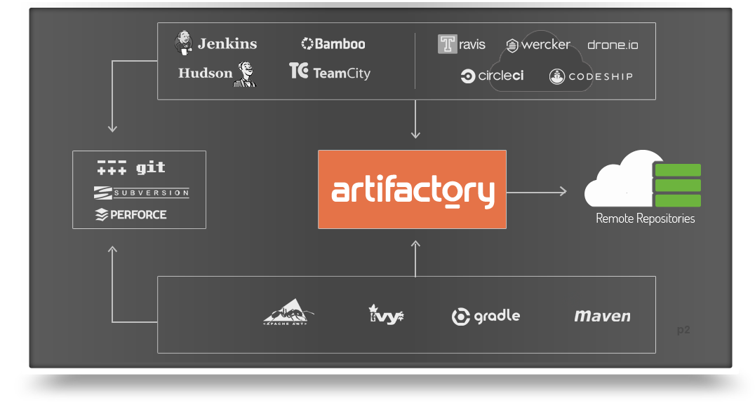
Artifactory Architecture
Robust Architecture

Slide 8
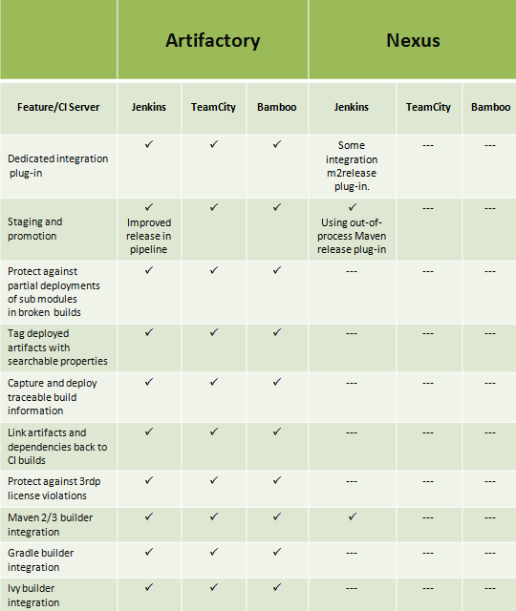
Artifactory Vs Nexus - Cont.….

Slide 9
Features of Artifactory
Supports p2 eclipse plugin repository,nugget,gradle,ivy,npm,yum and many more
Supports Crowd SSO, LDAP integration, JIRA issue integration.
Watchers, Good UI to manage Administrative part and permissions
Upload artifacts from UI
Supports build promotion, after build promotion update the version in pom.xml
Manages in-house Docker containers.
Store build data, which helps in traceability.

Slide 10
Artifactory Repositories
Artifactory hosts three types of repository:
Local
Remote
Virtual
Local and remote repositories are true physical repositories.
While a virtual repository is actually an aggregation of them used
to create controlled domains for search and resolution of artifacts.
To configure repositories, in the Admin tab, go to Configuration | Repositories.
Repositories can be created, deleted, edited, ordered and aggregated.

Slide 11
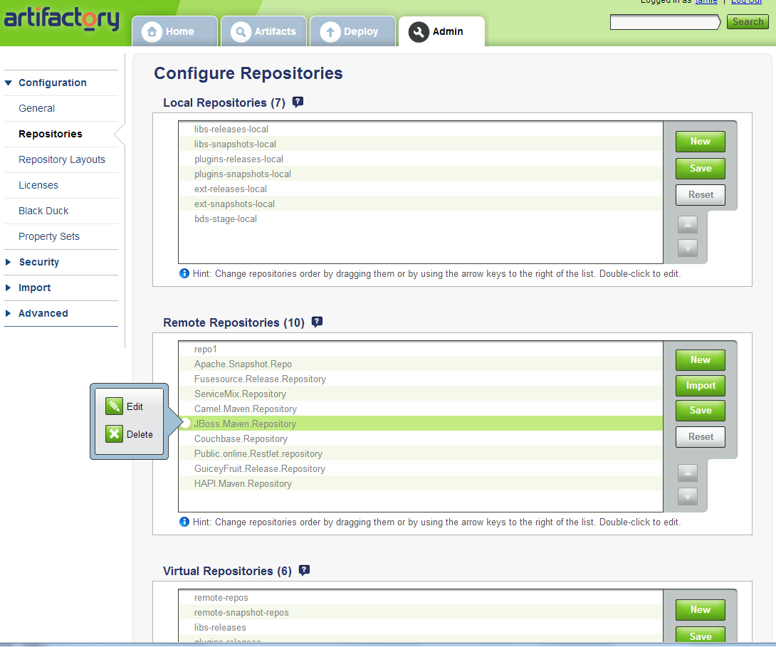
Artifactory Repositories – Cont …

Slide 12
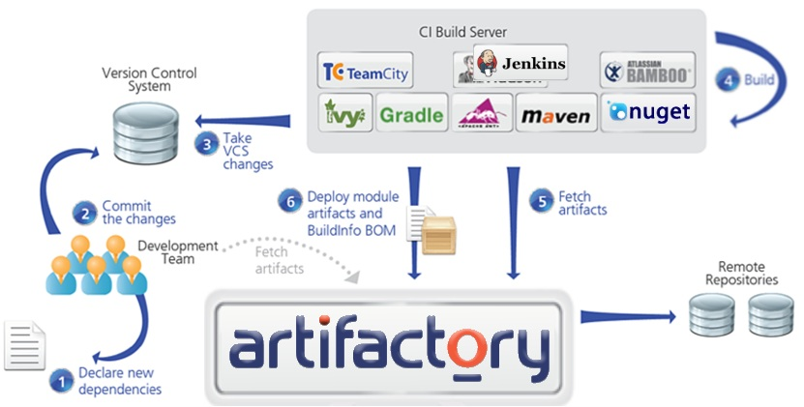
Artifactory With DevOps and Ecosystem

Slide 13


Artifactory and Jenkins
Artifactory and Jenkins
Deploy from Jenkins to Artifactory
Navigate the builds in Artifactory
Link back to Hudson builds
Export/promote/manipulate build artifacts
More efficient multi-module deployment

Slide 14
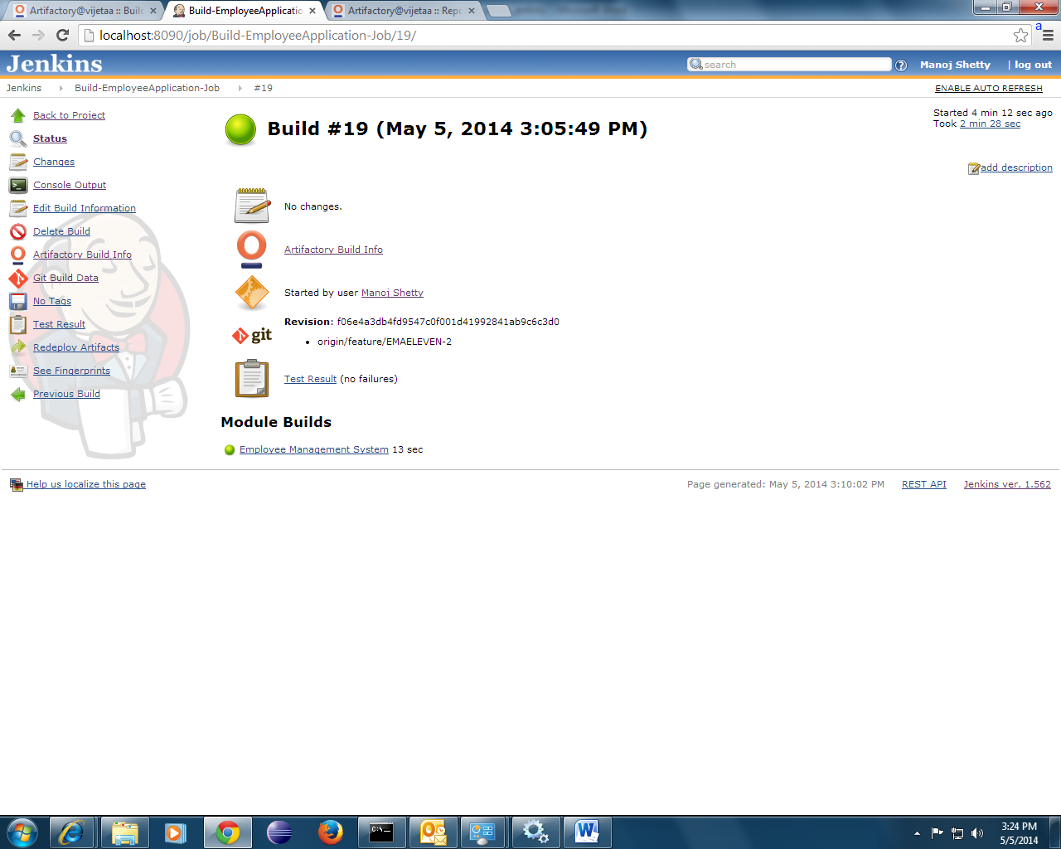
Artifactory and Jenkins – Cont…

Slide 15

Any Questions?

Slide 16
Thank You!

